Slide 1

STRUCTURED ACADEMIC CONTROVERSY
STRUCTURED ACADEMIC CONTROVERSY
STRUCTURED ACADEMIC CONTROVERSY
STRUCTURED ACADEMIC CONTROVERSY
The Relevance
The thought
The classroom method
The online method
Facilitator’s role
Participant’s role
The benefits and issues
Best practices
A sum up
STRUCTURED ACADEMIC CONTROVERSY
STRUCTURED ACADEMIC CONTROVERSY

Slide 2
The Relevance

Slide 3

We live in a society. We are not isolated. Every single day we come across issues, challenges and agendas some we agree with and some we don’t. We love participating in polls. Agreeing or disagreeing with issues and opinions is like a power drug. We express our opinion and we feel the power.
But we avoid controversies

Slide 4
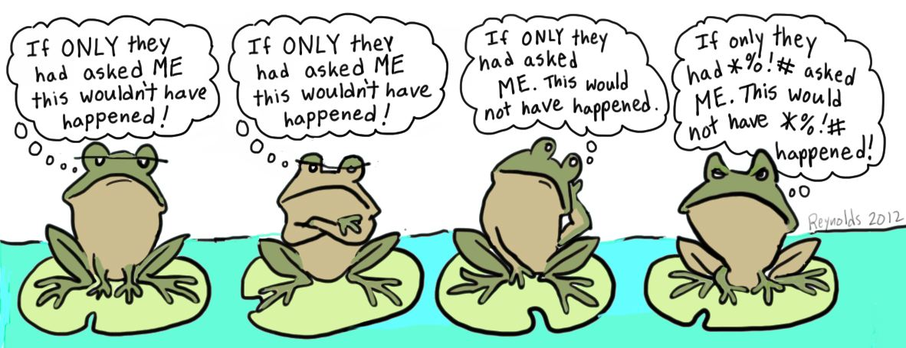
For years we keep training self to have a point of view and so do we train our kids, as opinion building is crucial to intellectual development. But we often forget to look beyond the side we are standing on. We call it our side and we are staunch about it. The other side is simply not our choice.
As we avoid controversies

Slide 5
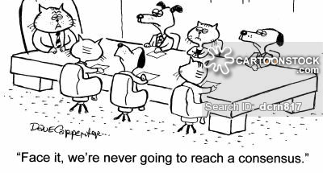
In our multi-ethnic society, it is crucial for students to have a balanced appreciation of another’s cultures and point of view, to build towards a consensus and not a conflict.
And yet we avoid controversies

Slide 6
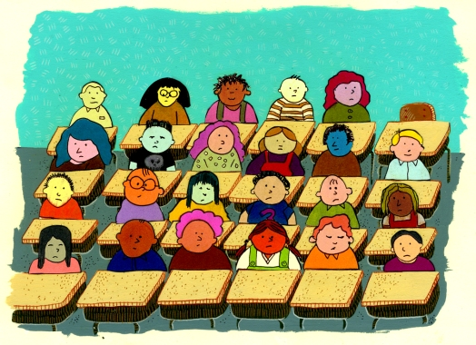
Conflicts are the accepted writer’s tools to capture audience, yet teachers often supress students’ academic disagreements and miss out their opportunity to capture their own audiences and enhance learning.
As we avoid controversies

Slide 7

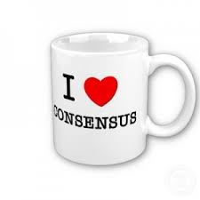
MORE THAN JUST A CLASS DEBATE, SAC HELPS STUDENTS TAKE ON MULTIPLE Perspectives AND NEGOTIATE TOWARDS A SHARED CONSENSUS.
IF ONLY OUR STUDENTS COULD HAVE MORE OPPORTUNITIES TO PRACTSIE SAC,
PERSPECTIVE-TAKING AND CONSENSUS-DRAWING WILL BECOME A HABIT OF MIND.

Slide 8
The thought

Slide 9
PROCESS OF CONTROVERSY. Johnson, D.W., Johnson, R.T., & Smith, K.A. (1991).
Active Learning: Cooperation in the college classroom.
4
Experiencing
Conceptual conflict
Uncertainty
Disequilibrium
Involvement in a controversy
2 Active representing and elaborating of position and rationale
3 Being challenged by opposite views
Positive Attitudes
Interpersonal attraction
Perceived peer support
Liking for decision, topic, and controversy
Self esteem
5
Epistemic Curiosity
Active search for more information
Understanding opposing positions and rationale
Productivity
High-quality decision making
Achievement and retention
High continuing motivation
High creativity
1
Categorizing
Organising, and deriving conclusions from present information and experiences
6
Reconceptualization
Incorporation of opponents’ information and reasoning
Accuracy and perspective taking
Attitude and position change
Transition to higher stages of cognitive reasoning

Slide 10
PROCESS OF CONTROVERSY. Johnson, D.W., Johnson, R.T., & Smith, K.A. (1991).
Active Learning: Cooperation in the college classroom.
1
Categorizing
Organising, and deriving conclusions from present information and experiences

Slide 11
PROCESS OF CONTROVERSY. Johnson, D.W., Johnson, R.T., & Smith, K.A. (1991).
Active Learning: Cooperation in the college classroom.
Involvement in a controversy
2 Active representing and elaborating of position and rationale
3 Being challenged by opposite views

Slide 12
PROCESS OF CONTROVERSY. Johnson, D.W., Johnson, R.T., & Smith, K.A. (1991).
Active Learning: Cooperation in the college classroom.
4
Experiencing
Conceptual conflict
Uncertainty
Disequilibrium

Slide 13
5
Epistemic Curiosity
Active search for more information
Understanding opposing positions and rationale

Slide 14
Positive Attitudes
Interpersonal attraction
Perceived peer support
Liking for decision, topic, and controversy
Self esteem
Productivity
High-quality decision making
Achievement and retention
High continuing motivation
High creativity
6
Reconceptualization
Incorporation of opponents’ information and reasoning
Accuracy and perspective taking
Attitude and position change
Transition to higher stages of cognitive reasoning
PROCESS OF CONTROVERSY. Johnson, D.W., Johnson, R.T., & Smith, K.A. (1991).
Active Learning: Cooperation in the college classroom.

Slide 15
The classroom method

Slide 16















STEP 1
PICK A CONTROVERSIAL ISSUE
Divide the students
Students study to build their point of view
STEP 2
STEP 3
Students engage in a rebuttal. Each defends their side
EACH TEAM PRESENTS THEIR SIDE, AND ARE CHALLENGED BY THE OPPOSITE VIEWS
Students study to build their point of view

Slide 17





STEP 4
Students exchange positions and repeat Steps 1, 2 and 3
STEP 1
PICK A CONTROVERSIAL ISSUE
Divide the students
Students study to build their point of view
A
B
A
B
STEP 2
STEP 3
each team presents their side, and are challenged by the opposite views
Students engage in a rebuttal. Each defends their side
Students study to build their point of view
STEP 5
Students leave their assigned position and reach a consensus

Slide 18
The online method

Slide 19
SAC online
Online collaborative debate
Progressive Project
Structured controversy forum

Slide 20
Tools
Forums
Voice thread
Social networks

Slide 21
Facilitator’s role

Slide 22


Establish a Constructive context
Competitive context
Cooperative context

Slide 23
Pre-instructional decisions and preparations
Set objectives and select topic
Decide on the size of the group
Assign students to groups
Arrange the room
Plan instructional materials
Assign roles

Slide 24
Orchestrating
Explain academic task
Structure the controversy
Structure positive interdependence
Structure individual accountability
Explain criteria for success
Specify desired behaviors

Slide 25
Monitoring and intervening
Observe interaction among group members
Ensure adherence to controversy procedures
Provide academic assistance
Teach controversy skills

Slide 26
Evaluating and Processing
Celebrate as a group
Provide closure
Assess and evaluate student learning
Process how well the group did

Slide 27
Students’ role

Slide 28

Be respectful of each other.
Disagree with another person's position and ideas but not the person.
Don't take criticism of your ideas as a personal attack.
Listen to everyone's ideas, especially if you don't agree with them.
Change your mind when the evidence supports this.
Try to understand both sides of the controversy.
Understand the position differences before trying to reach consensus.
Focus on reaching the best outcome, not on winning.

Slide 29
The issues

Slide 30

What fails
Classroom climate is competitive
Lack of heterogeneity in viewpoints and information
Unskilled and hostile students
Failure to reason logically and rationally
academic controversy?

Slide 31
Best practices

Slide 32

Information is accurately communicated
Promotes a supportive climate
Controversies are not win-loose situations
Controversy is valued
There is heterogeneity among group members
All Information is communicated and synthesized effectively
A side is not valued as it is politically correct
Disagreement does not lead to loosing competence
Rationale and evidence is the basis of decision making
Practice active listening
Challenge ideas not people
Share the floor: each person must have the opportunity to speak
Success of Structured Academic Controversy depends on…

Slide 33
A sum up

Slide 34


Through controlled argumentation, students can broaden their perspectives, learn material more thoroughly, and make better decisions.

Slide 35
Compared to the other cooperative learning strategies including individualistic, concurrence seeking and debate, academic controversy not just leads to
Deriving conclusions by categorizing and organizing information and experiences
.

Slide 36
But also leads to :
Cognitive conflict
High Epistemic curiosity
Active representation and elaboration of position and rationale
High reconceptualization
High productivity
High cachexia
.

Slide 37

“Conflict is the gadfly of thought. It stirs us to observation and memory. It instigates invention. It shocks us out of sheep-like passivity, and sets us at noting and contriving…conflict is a sine qua non of reflection and ingenuity.”

Slide 38
STRUCTURED ACADEMIC CONTROVERSY
STRUCTURED ACADEMIC CONTROVERSY
STRUCTURED ACADEMIC CONTROVERSY
STRUCTURED ACADEMIC CONTROVERSY
References
Barkley, E. F. (2010). Student engagement techniques: A handbook for college faculty. San Francisco: Jossey-Bass.
Jacobs, George M. "The Academic Controversy Technique: Towards Cooperative Debates." Online Submission (2010): ERIC. Web. 2 June 2014.
Johnson, D. W., Johnson, R. T., and Smith, K. A. (1998). Active learning: Cooperation in the college classroom. Edina, MN: Interaction Book Company
Johnson, D., Johnson, R., & Smith, K. (1996). Academic controversy: enriching college instruction through intellectual conflict. ASHE-ERIC Higher Education Reports, 25(3), 1-123.
Johnson, D.W. and R.T. Johnson. 1988. Critical thinking through controversy. Educational Leadership May 1988: 58-64
Glowacki-Dudka, & Barnett, N. (2007). Connecting critical reflection and group development in online adult education classrooms. International Journal of Teaching and Learning in Higher Education, 19(1), 43-52
STRUCTURED ACADEMIC CONTROVERSY
STRUCTURED ACADEMIC CONTROVERSY

Slide 39


STRUCTURED ACADEMIC CONTROVERSY
STRUCTURED ACADEMIC CONTROVERSY
STRUCTURED ACADEMIC CONTROVERSY
STRUCTURED ACADEMIC CONTROVERSY
STRUCTURED ACADEMIC CONTROVERSY
STRUCTURED ACADEMIC CONTROVERSY

